Slide 1


MIS Recommendation for Geeland International Grocery

Slide 2
TABLE OF CONTENTS
01
02
03
04
05
Organization
Operations
Database Design
MIS Recommendation
E-Commerce

Slide 3
01
Organization

Slide 4
Context and General Information
Geeland International Grocery is a family-owned specialty grocery store situated at 1620 Walkley Road in Ottawa, Ontario, offering a diverse array of international food products. It caters to Ottawa's multicultural community, providing a unique shopping experience focused on authentic global flavors
Industry : Retail
Economic Group : Small to Medium-sized Enterprises(SMEs)
Competitors : Local retail chains, online retailers
Incumbents : Walmart, Costco

Slide 5
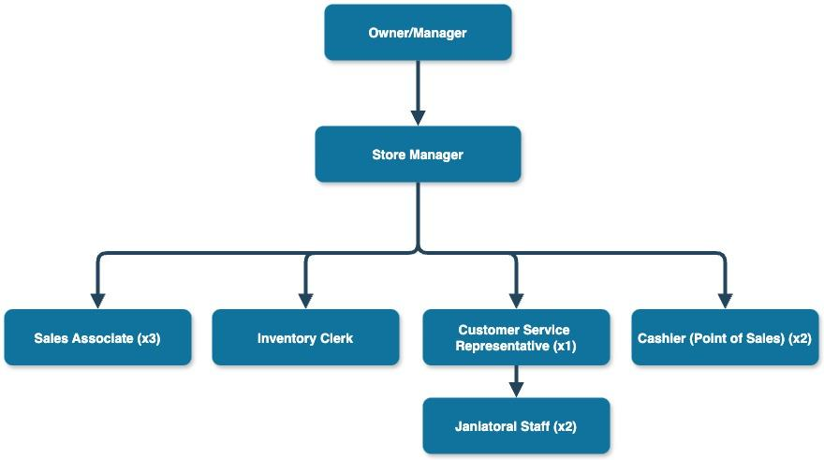
Organization Chart

Slide 6
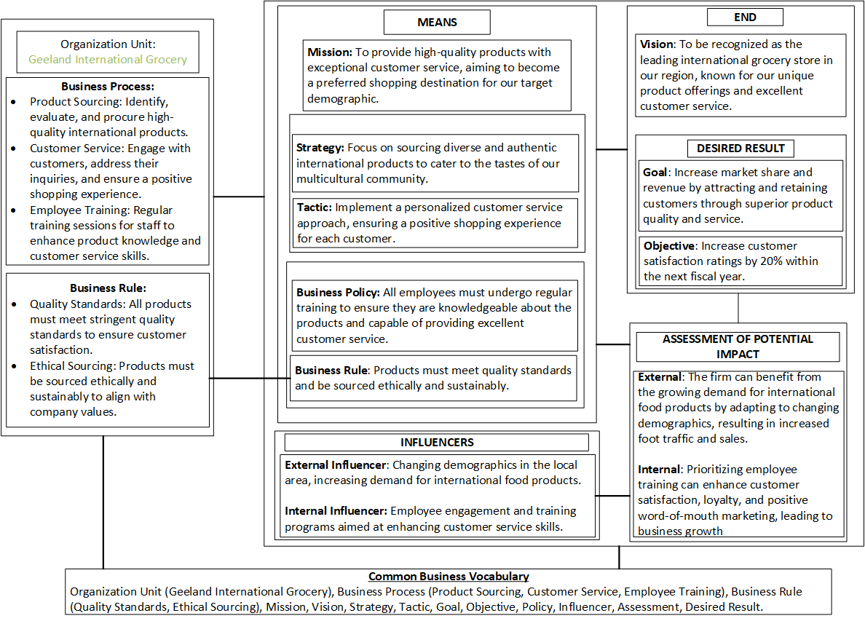
Business Strategy
Business Motivation Model (BMM)

Slide 7
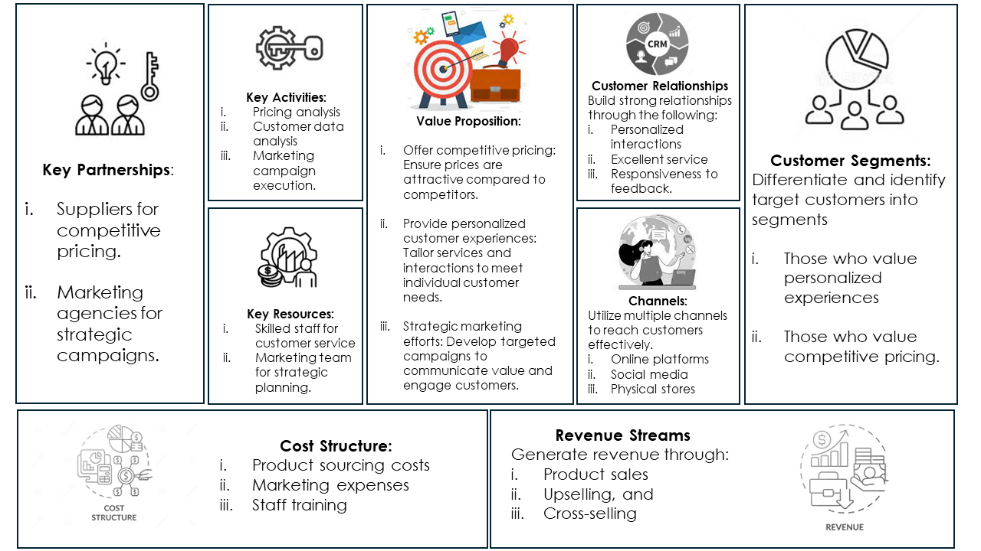
Business Strategy
2. Canvas Model

Slide 8
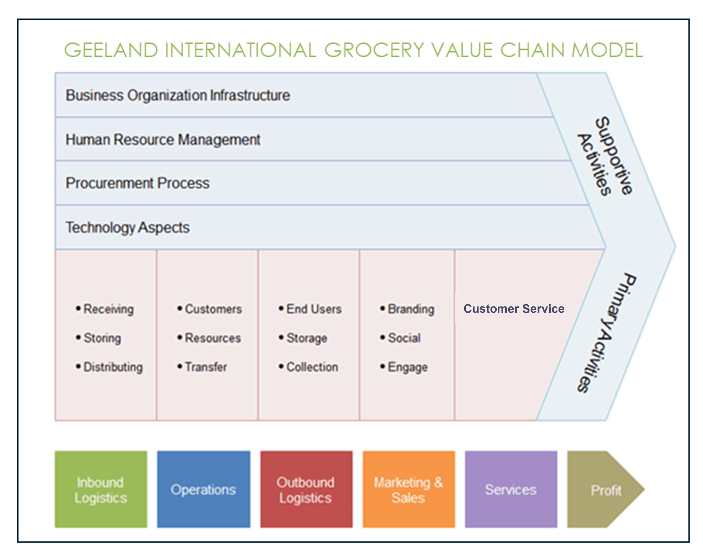
Business Strategy
3. Value System Model

Slide 9
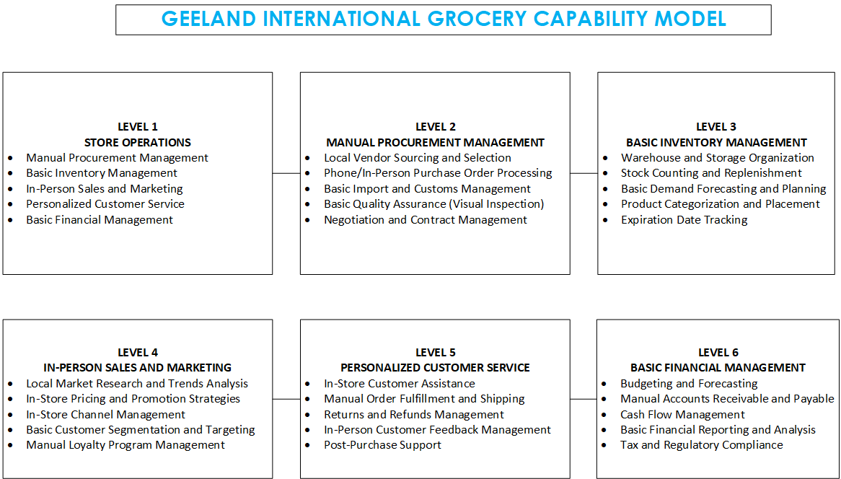
Business Strategy
4. Capability Analysis

Slide 10
02
Operations

Slide 11
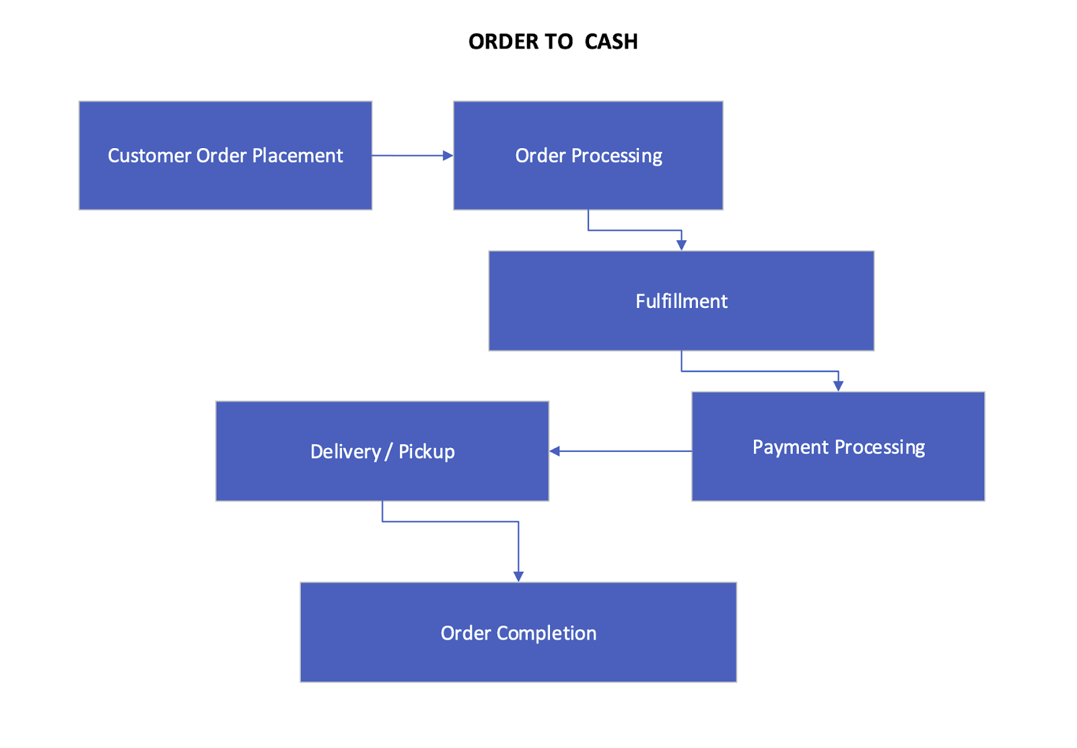
Process Identification
Order to Cash
Customer Order Placement
Order Processing
Fulfilling orders by selecting items from inventory
Payment Processing
Delivery/Pickup
Order Completion

Slide 12
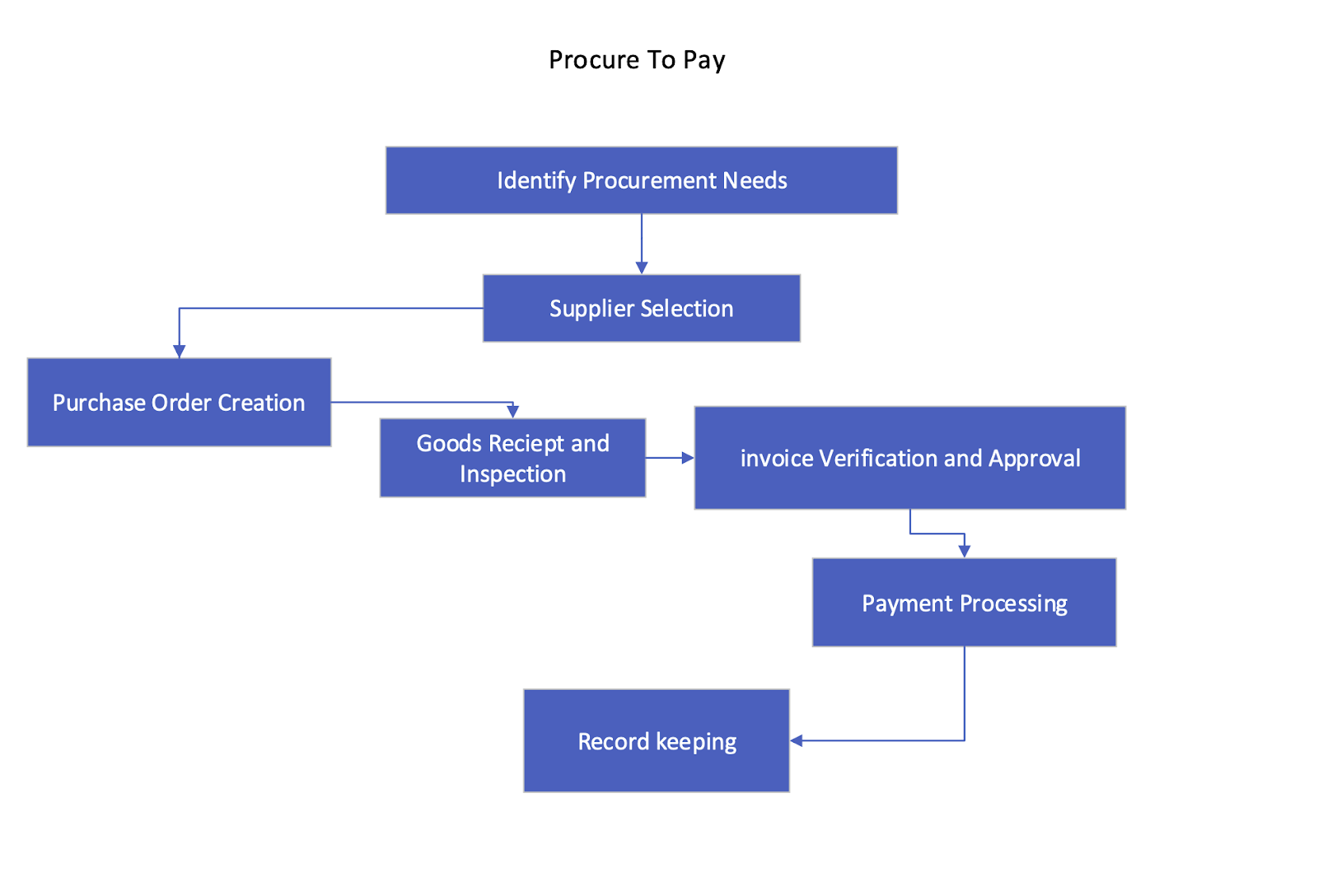
Process Identification
B. Procure to Pay
Identify Procurement Needs
Supplier Selection
Initiating purchase orders
Receiving deliveries from suppliers
Verifying received goods
Invoice Verification & Approval
Processing payments
Record Keeping

Slide 13
Process Mapping
Strategy Process
Core Process
Support Process
Analyzing market trends
Customer preferences
Competitor strategies
Order fulfillment
Procurement
Sales and Marketing
Human Resources
Financial Management
IT Support

Slide 14
03
Database Design

Slide 15
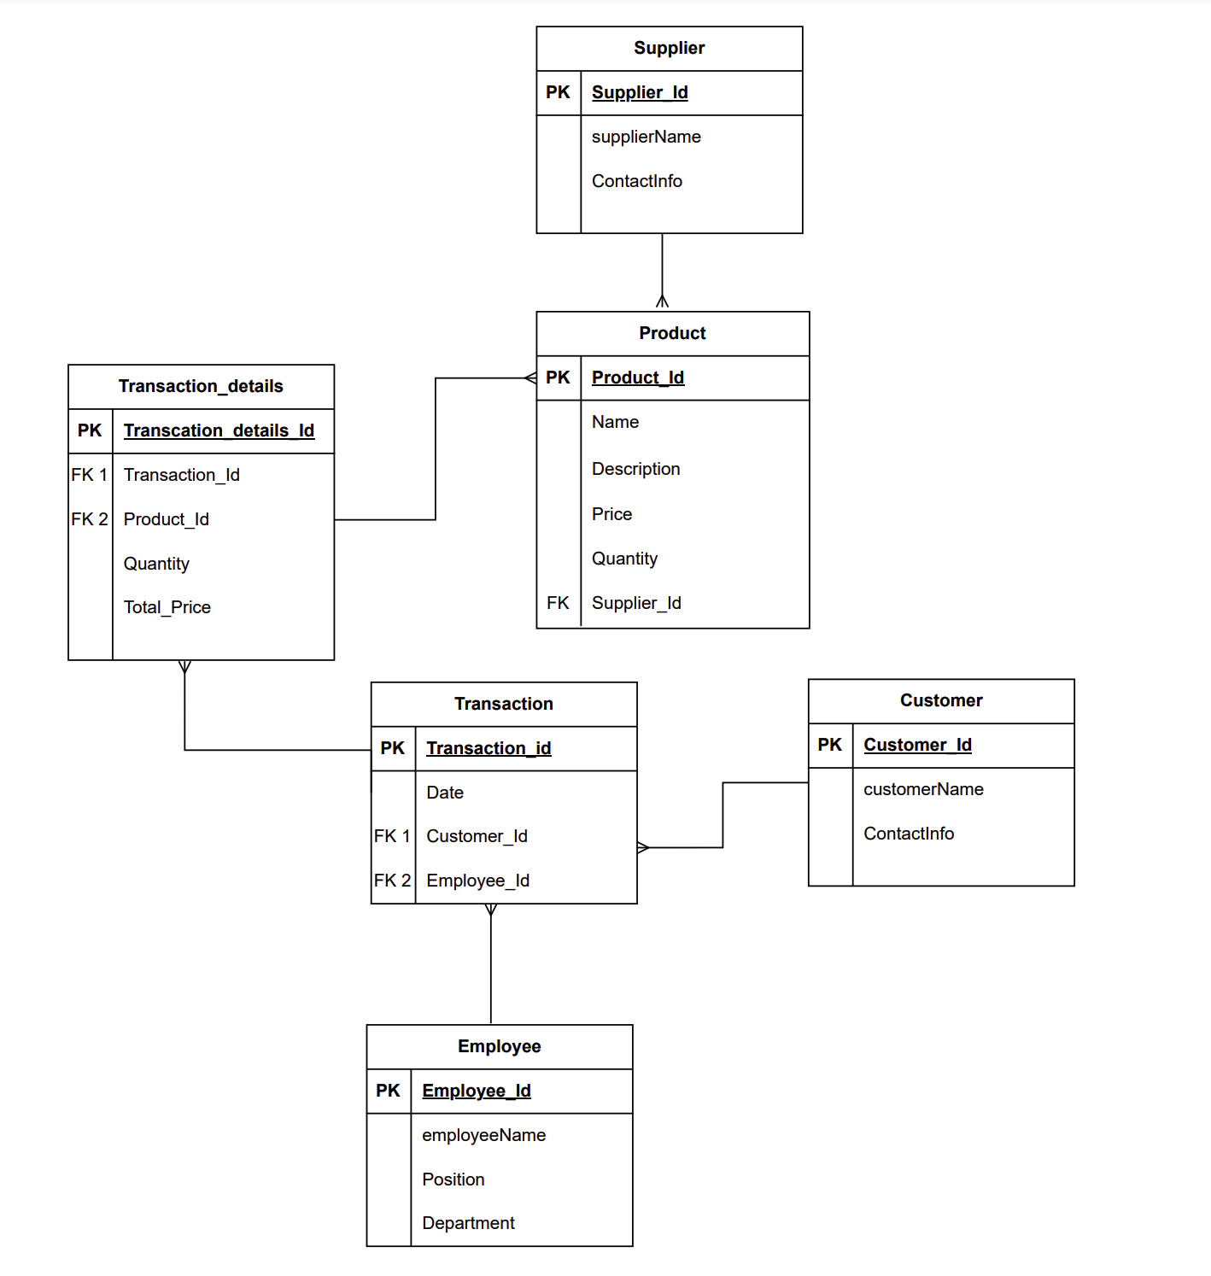
Entity Relationship Diagram

Slide 16
04
MIS Recommendation

Slide 17
Problem Areas
Lacks an efficient point-of-sale (POS) system
Lacks a structured approach to managing customer relationships
Lacks comprehensive insights into its sales performance
Inefficient invoicing and payment processes

Slide 18
Proposed Solution
Platform
Odoo: Odoo is an open-source enterprise resource planning (ERP) software that offers centralized data management, automated reporting, advanced analytics, forecasting capabilities, and seamless integration, all of which streamline operations and enhance efficiency.
Why Odoo for Geeland International Grocery
Odoo centralizes sales, inventory, and customer data for streamlined management
Automated reporting in Odoo ensures accurate sales reports with time-saving efficiency
Odoo's analytics tools offer deep insights into sales, customer behavior, and market trends
Automated reporting in Odoo ensures accurate sales reports with time-saving efficiency.

Slide 19
Top-level Process
Order to Cash :
Set up Point of Sale
Add Products
Configure Payment Methods
Payment Methods
Customize Receipts
Manage Cash Controls
Set up User Accounts
Start Selling
Monitor Reports

Slide 20
Top-level Process
Procure to Pay :
Identify Needs
Create Purchase Requisition
Generate a Request for Quotation (RFQ)
Create a Purchase Order
Issue Goods Receipt
Invoice Matching & Approval
Vendor Payment
Track Vendor Performance

Slide 21
Demo for Top-level Process
Order to Cash :
https://geeland-international-grocery.odoo.com/odoo/point-of-sale?cids=1
Procure to Pay :
https://geeland-international-grocery.odoo.com/odoo/inventory/2/action-538?cids=1

Slide 22
02
E-Commerce

Slide 23
E-Commerce
E-commerce in Odoo Platform Demo
https://geeland-international-grocery.odoo.com/

Slide 24
Thank You!

